Slide 1
1
PAPER PRESENTATION
A Comparative Study on Machine Generated Text
Detection Using LLM Models
Course: Applied Data Science
Course Code: CSE438
Team No: 13
Washikur Rahman
Shihab Musa
Adnan Al Sayeed Sihab

Slide 2
Table of contents
01
02
03
04
05
06
07
2
ABSTRACT OVERVIEW
INTRODUCTION
RELATED WORKS
DATASET
METHODOLOGY
MODEL EVALUATION
LIMITATION,
Future Work &
Conclusion

Slide 3

3
ABSTRACT OVERVIEW
Distinguishes machine-generated text from human-written text using pre-trained language models like BERT and RoBERTa for improved transparency online
Gathers a balanced collection of machine and human texts, preprocesses and labels the data, then trains and evaluates classification models on the dataset
Analyzes errors to understand model biases and limitations, with the goal of enhancing reliability and mitigating threats like deep fakes online.

Slide 4
INTRODUCTION
4
Significant recent progress in natural language processing capabilities through advanced AI models like GPT-3 which show human-like writing but also ability to generate fake or misleading content.
Need for methods to identify machine-generated text as these models proliferate to maintain integrity of online information and avoid misuse. Researchers exploring techniques like statistical analysis of text patterns, inconsistencies, and fact-checking.
Promising approach of adversarial training where one model generates text and another detects differences between human and AI writing. Through iterative training both improve and this co-evolution supports more effective detection of machine-generated material.

Slide 5
Related Work
5
Sadasivan et al. (2023) suggests using neural paraphrasers like T5 and PEGASUS to conduct paraphrasing attacks to identify machine text and emphasizes the need for more study in AI text authentication.
Alamleh et al. (2023) assesses machine learning models to differentiate ChatGPT text from human text, finding RF and SVM perform well, but highlights the need for larger, more varied datasets and improved feature selection.
Katib et al. (2023) uses TSA-LSTM RNN with feature extraction methods to distinguish ChatGPT from human text, outperforming other techniques.
Desaire et al. (2023) provides a technique to accurately identify paragraphs written by AI instructing ChatGPT to mimic chemists, but notes limitations and need for more investigation.
Vygon and Mikhaylovskiy (2023) combines embeddings and kNN for speech data keywords, emphasizing efficient feature extraction and classification importance, but acknowledges dataset limitations.

Slide 6
6
DATASET
Comprises 119,756 text samples from diverse sources and genres, split evenly between human-generated (63,351 samples) and machine-generated (56,406 samples) texts.
Includes an additional 5000 samples for validation, ensuring a balanced distribution crucial for robust and unbiased model development and evaluation.
Uses a balanced dataset from SemEval containing texts from both machines and humans, preprocessed with tokenization to capture linguistic structures.
Labels are encoded as 0 for human-generated and 1 for machine-generated, with a stratified 80-20 split of 95,806 training and 22,950 test samples to reduce bias and biases and ensure a credible dataset.

Slide 7
7
METHODOLOGY
Utilizes pre-trained BERT-base-cased model containing 12 transformer blocks and 12 attention heads trained on BookCorpus and Wikipedia. Adds classification layer with sigmoid to output probability of text being human or machine generated.
Initializes BERT weights, trains end-to-end on labeled dataset with binary cross-entropy loss, Adam optimizer, batch size of 16, learning rate of 1e-5 for 1 epoch with early stopping. Evaluates on test set with accuracy, precision, recall, F1.
Also utilizes pre-trained RoBERTa-base model which improves on BERT by using more data and dynamically changing masking. Initializes RoBERTa weights and fine-tunes end-to-end for classification task in same way as BERT. Compares RoBERTa and BERT performance on test set.

Slide 8
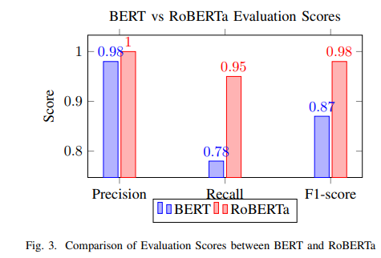
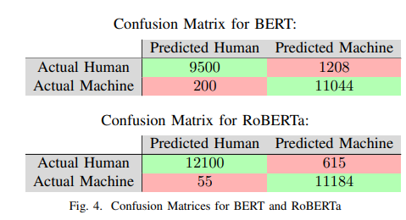
8
MODEL EVALUATION
BERT achieves high precision for both classes but lower recall for 'Human' class at 0.78, indicating room for improvement in identifying human labels. Overall validation accuracy is 87.65%.
RoBERTa achieves near perfect precision and recall for both classes, with F1-scores of 0.98 for 'Human' and 0.97 for 'Machine', showcasing robust performance with minimal misclassifications.
In comparison, RoBERTa outperforms BERT with perfect precision for 'Human', higher recall for both classes, and elevated F1-scores. Substantial support values further validate RoBERTa's reliability in accurately classifying human and machine text.

Slide 9
9
LIMITATION, CONCLUSION & FUTURE WORK
A limitation is the constrained computational hardware used for training, which could impact model scalability and performance in resource-intensive scenarios.
In conclusion, BERT outperformed RoBERTa on two validation sets, but both achieved satisfactory F1 scores over 0.7 for most classes. However, the study is limited by computational resources.
Future work will create a hybrid model using an architecture that concurrently processes text with CNNs for spatial hierarchies and LSTMs for temporal dependencies. Combining results seeks to improve discriminative ability for differentiating human from machine text.

Slide 10
10
Reference
Sadasivan, V.S. et al. (2023). ”Can ai-generated text be reliably detected?” arXiv.org. Available at: https://arxiv.org/abs/2303.11156
JAlamleh, H. et al. (2023). ”Distinguishing Human-Written and ChatGPT-Generated Text Using Machine Learning.” 2023 Systems and Information Engineering Design Symposium (SIEDS).
Katib, I. et al. (2023). ”Differentiating Chat Generative Pretrained Transformer from Humans: Detecting ChatGPT-Generated Text and Human Text Using Machine Learning.” Mathematics, 11(15), 3400.
Desaire, H. et al. (2023). ”Accurately Detecting AI Text when ChatGPT is Told to Write like a Chemist.” arXiv.org. Available at: https://arxiv.org/abs/2304.25683
Vygon, A. and Mikhaylovskiy, A. (2023). ”Learning Efficient Representations for Keyword Spotting with Triplet Loss.” arXiv.org. Available at: https://arxiv.org/abs/2305.18942

Slide 11
Thank You

